Slide 1
Automated Fish Health Monitoring for Aquaculture using Deep Learning
- Gokul

Slide 2
Agenda
Introduction
Problem statement
Project objective
Coding
Outputs

Slide 3
Introduction
In fish farming, monitoring fish health is very important because dead fish can quickly affect water quality and spread disease to healthy fish. In large fish farms, manual monitoring is inefficient. So, I built an AI-based system using deep learning that can automatically detect whether a fish is alive or dead using images and video streams.

Slide 4
Problem Statement
In fish farming environments, dead fish are often not detected immediately. This delayed detection can:
Contaminate water quality
Spread diseases to healthy fish
Reduce overall farm productivity
Increase operational costs

Slide 5
Project Objectives
To develop a Deep Learning-based system for detecting fish health status
To classify fish as Alive or Dead using image data
To extend the model for real-time video-based detection
To achieve reliable performance under real fish farm conditions
To reduce manual effort and enable early intervention in fish farming

Slide 6
📊 Dataset Overview
Dataset collected manually from random internet sources
Images related to fish farming and aquarium conditions
Two classes:
Alive Fish
Dead Fish
Total images used:
Alive Fish: 52
Dead Fish: 52
Dataset prepared specifically for this project

Slide 7
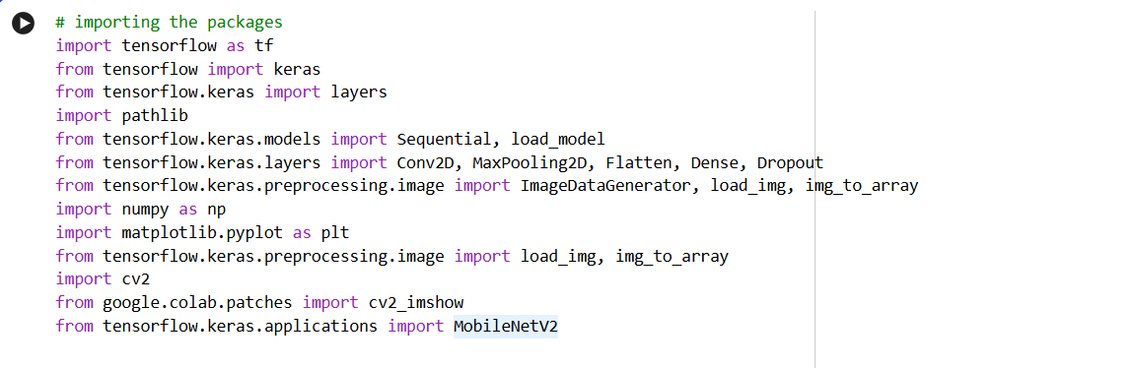
📊 Packages

Slide 8
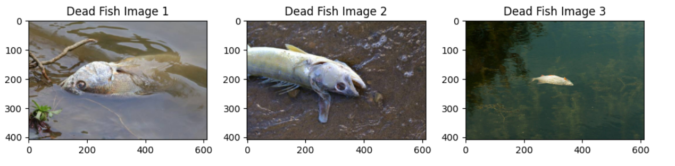
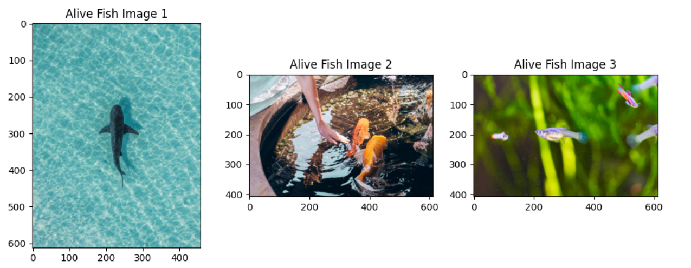
📷 Sample Dataset Images

Slide 9
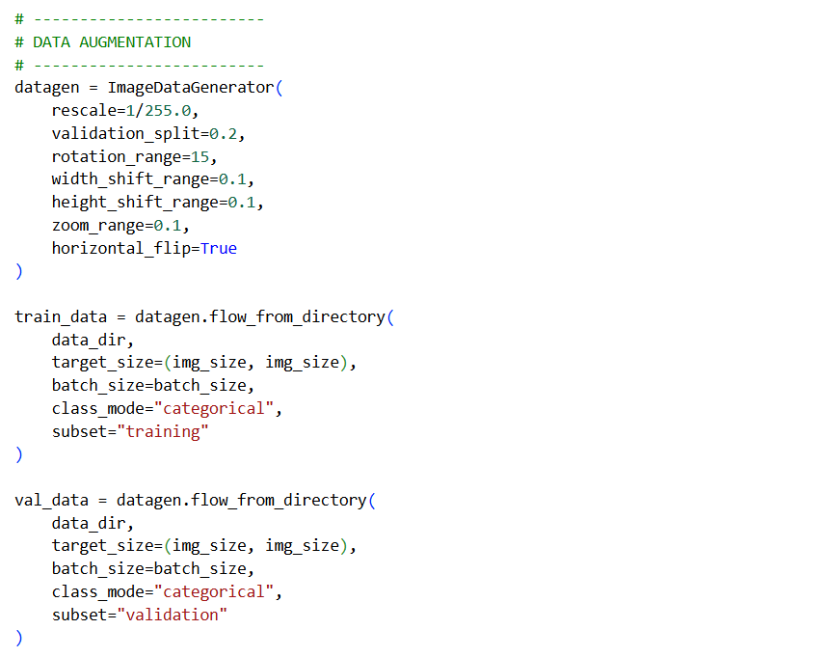
🧊Data Augmentation

Slide 10
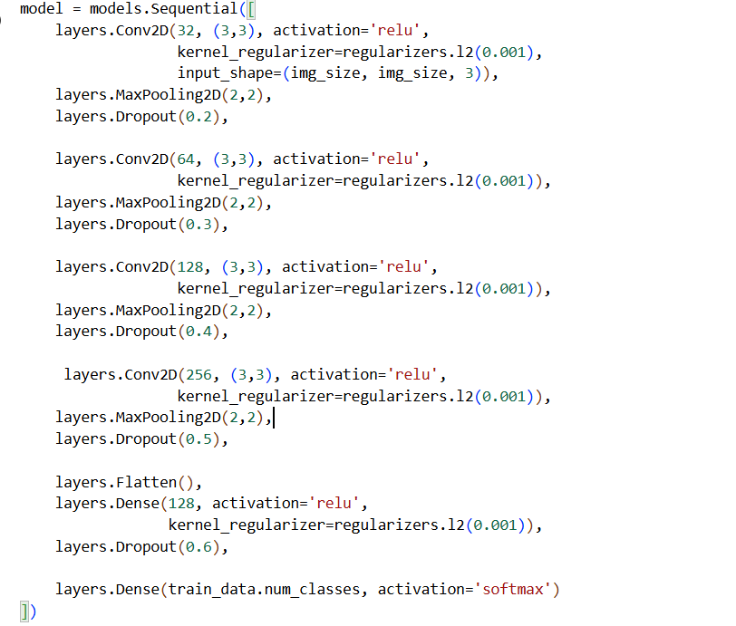
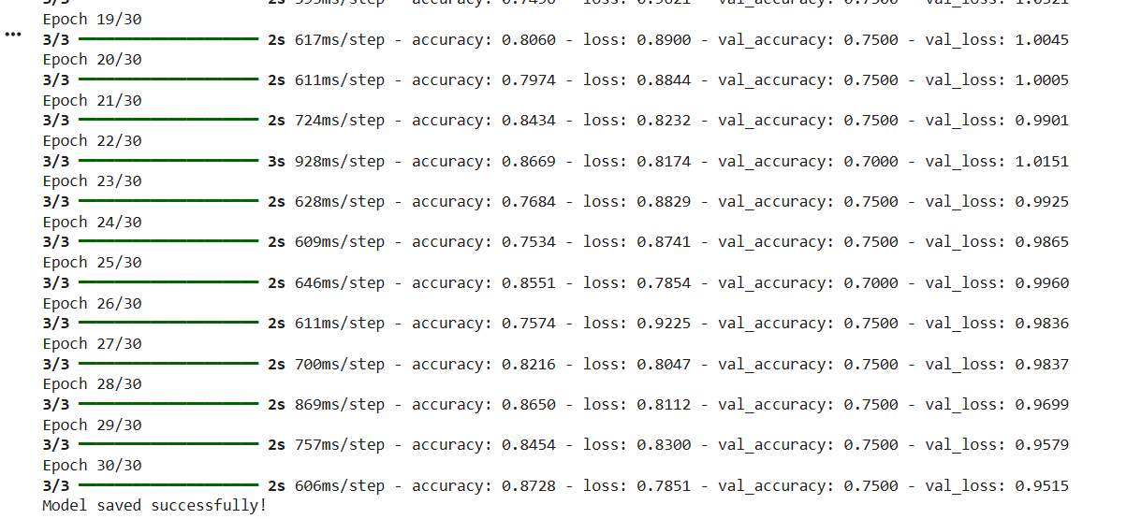
Convolutional Neural Network

Slide 11
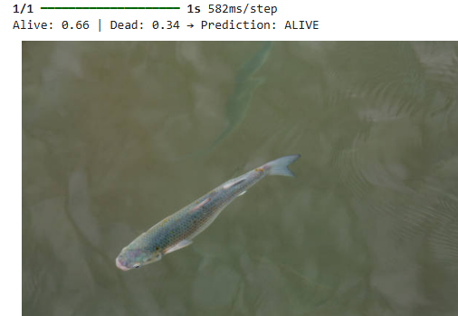
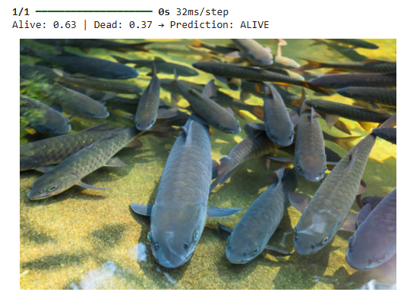
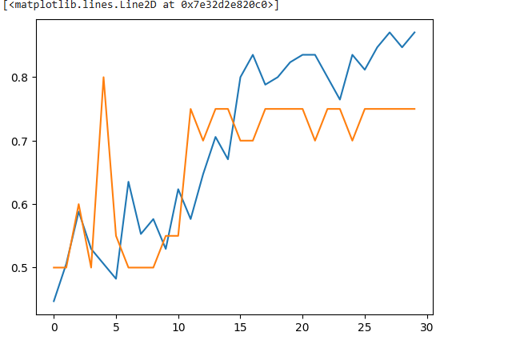
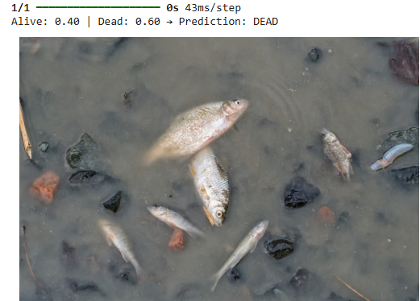
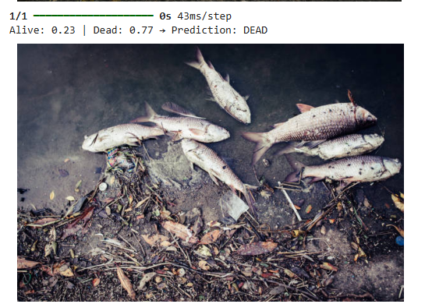
CNN Output
Training Accuracy vs Validation Accuracy

Slide 12
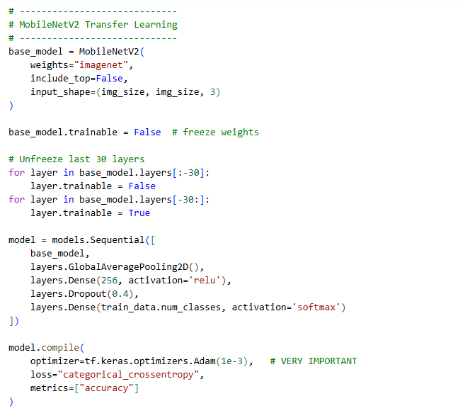
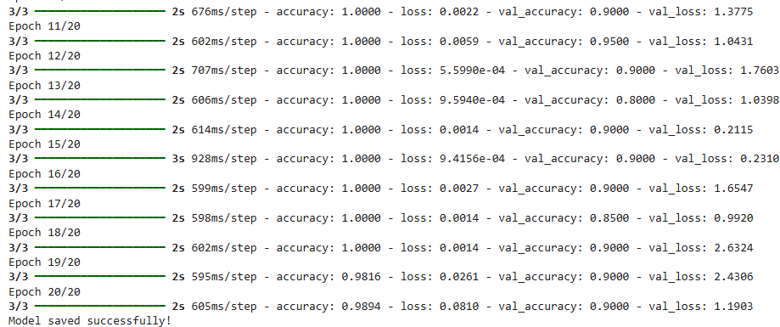
MobileNetV2 Transfer Learning

Slide 13
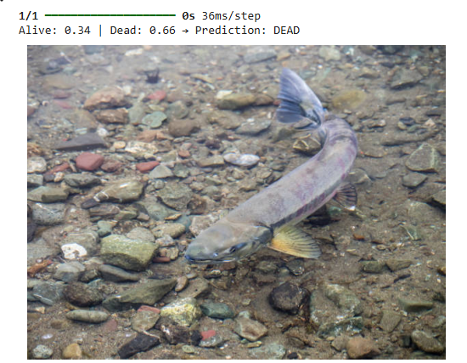
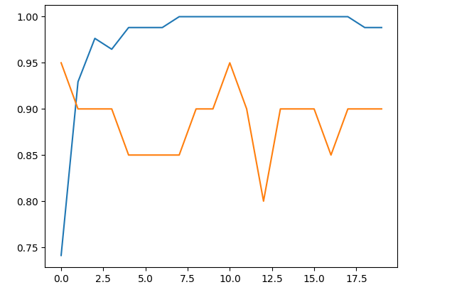
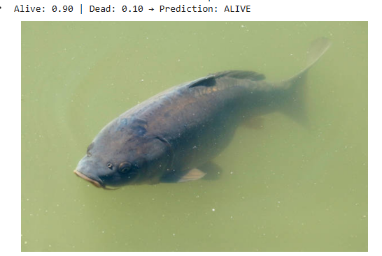
MobileNetV2 Output
Training Accuracy vs Validation Accuracy

Slide 14
📝 Model Comparison
Model | Correct Predictions (out of 10) | Accuracy | Observation
CNN | 9 / 10 | ~90% | Stable & reliable predictions
MobileNetV2 | 6 / 10 | ~60% | Less effective for this dataset
Final Model Selection: ✅ CNN was chosen because it provided better accuracy and consistent predictions for fish health classification.

Slide 15
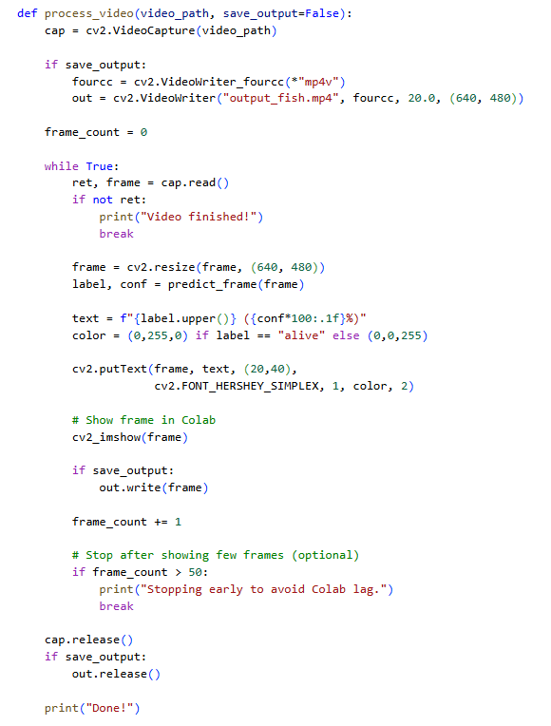
Processing the real time video

Slide 16
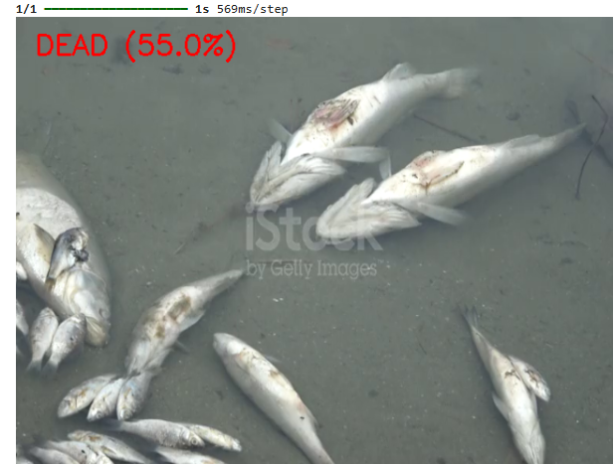
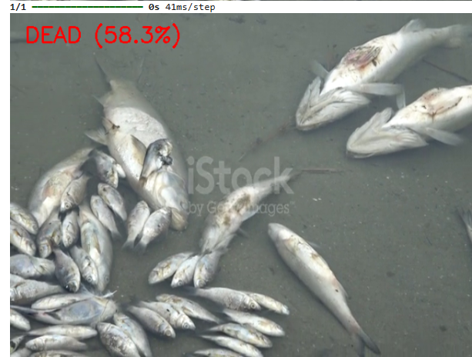
🔍Real time monitoring output

Slide 17
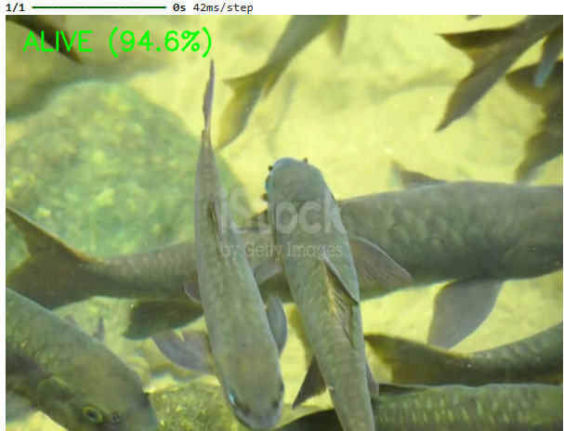
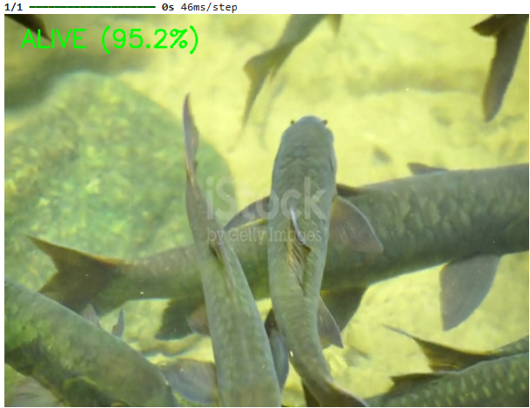
🔍Real time monitoring output

Slide 18
Thank you
LinkedIN: Gokul Madheshwaran | LinkedIn

